Slide 1
Developing an Ecosystem of Support

Slide 2
Who Are We?

Slide 3
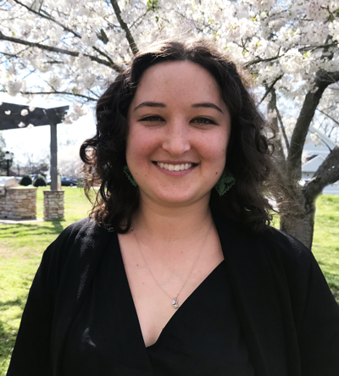
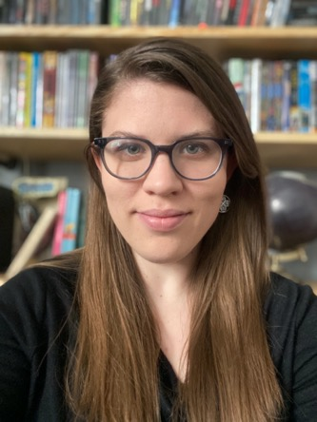
Natalie Flammia (she /her)
Professional Development Associate
Amber Stewart (she/her)
Program Associate

Slide 4
*Resource Hub*

Slide 5
Our mission is to create more equitable access to success for adult learners in Nashville.
We do this by:
Building a stronger network of providers to better serve more learners
Deepening the professionalism of the adult education field
Equipping our partners with tools, education, and resources to enhance their work
Promoting and providing resources for adult learners to achieve their personal, financial, civic, and academic goals

Slide 6
What Is an Ecosystem
of Support?

Slide 7
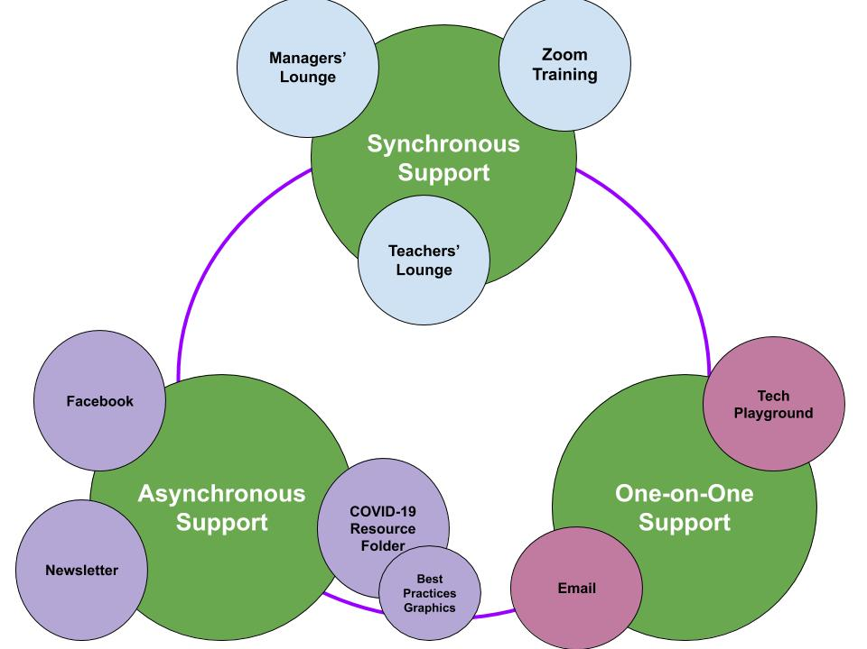

Slide 8
Synchronous Support

Slide 9
Teachers’ Lounge
A way for adult literacy educators to collaborate on common problems
What tools to use
Best practices for assessment
Making learning tools accessible
Protecting student privacy
Incorporating digital literacy

Slide 11
Notes:
Closed captioning available for video

Slide 12
I consider them an unexpected benefit of the COVID pandemic
[Adult Literacy Team Members] have revolutionized the original "communities of best practice" model!

Slide 13
Managers’ Lounge
A collaborative space built specifically for program managers.
Modified Mastermind model
Each participant brings a problem to solve and receives 10-15 minutes of solution-oriented discussion

Slide 17
Zoom Training
Offered to program administrators in the “train the trainer” model
Also offered to volunteers
Adjustable depending on skill level

Slide 18
Notes:
Closed captioning available for video

Slide 19
Asynchronous Support

Slide 20
Newsletter
Upcoming professional development events
Pressing updates and opportunities
National guidance
Community Corner
Encouragement

Slide 21
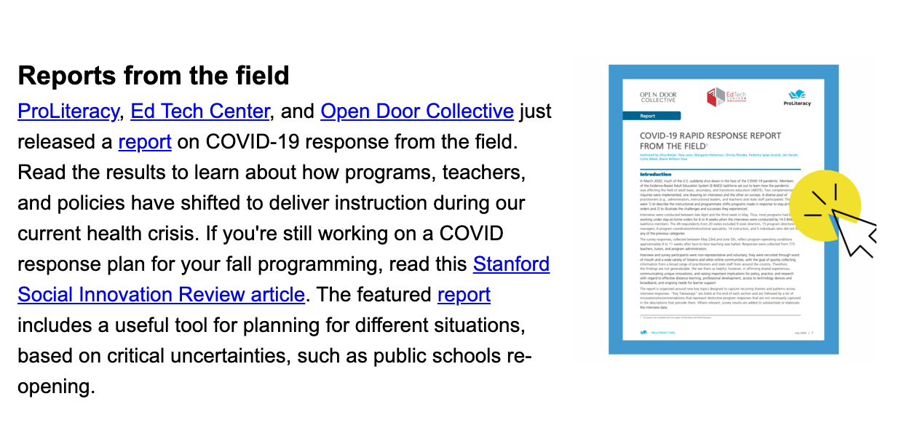

Slide 22
Private Facebook Group
Requests for support
Resource sharing
Job opportunities
Celebration
Community discussion

Slide 23
COVID-19 Response Folder
Intentional, organized, cloud-based file sharing.
Combat resource overload
Evaluated by the library
Indexed
Organized for Learners and Educators

Slide 24
Best Practices Graphics
Based on “what works” and “best practice”
Reinforcement
Easy sharing

Slide 25
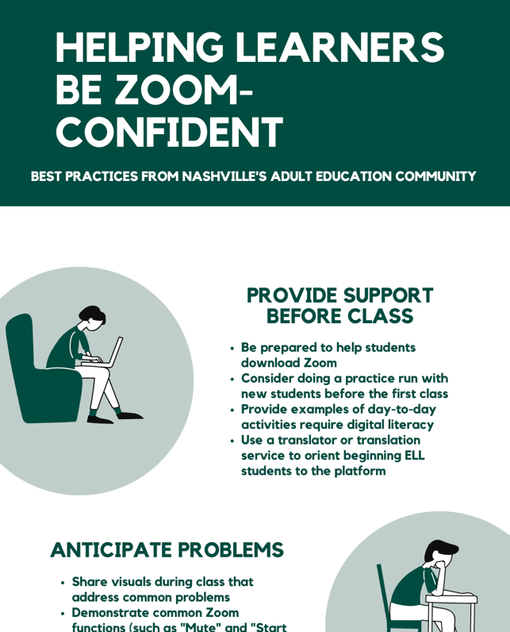
Community-led resource development
Mobile-first design

Slide 26
One-on-One Support

Slide 27
Tech Playground
25 min. tech support sessions for troubleshooting or practice.
Learner requested
Recommended for remedial support
Follow up with asynchronous supports

Slide 28
I am very grateful to you for your help. Sometimes, I waste hours trying to find out how to do something, when someone who knows what she's doing can solve my problem in a minute.

Slide 29
Adult Literacy Email
Shared management by library team
Less pressure when contacting the team

Slide 30
Keeping the Ecosystem Healthy

Slide 32
Center the learner
Priorities
Access
Accessibility needs
Interests and passions
What else?
What aren’t you seeing or asking?
Who is not at the table?

Slide 33
Questions to
Ask Yourself
Are you taking a top-down approach or a collaborative approach?
Where’s the follow-up?
Is there more than one avenue to access information?
Are your supports accessible to all different kinds of learners?

Slide 34
Q&A

Slide 35
Thanks!
ANY QUESTIONS?
amber.stewart@nashville.gov
natalie.flammia@nashville.gov
adultliteracy@nashville.gov

Slide 36
Plan to share your favorite tool, website, or app during the Smackdown! Be ready with the link. Each person is limited to 2 minutes so make it quick!
11:00
Tweet your learning! #techignite
Notes:
Smackdown – 11:35-11:50
Plan something quick to say about your favorite instructional
tool, website, or app! This is an "open mic" session where
anyone can share what works in their classroom or school.
Limit of 2 minutes each.

