Slide 1
Assistive Technology Playground
IGNITE 2017
Dr. Robbie Hampton

Slide 2
My Journey with Education and Technology
https://www.youtube.com/watch?v=Z-2e093A_LY

Slide 3
Definition
IDEA defines an 'assistive technology device' as... any item, piece of equipment, or product system, whether acquired commercially off the shelf, modified, or customized, that is used to increase, maintain, or improve functional capabilities of a child with a disability.

Slide 4
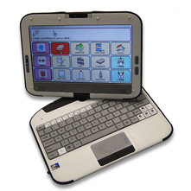
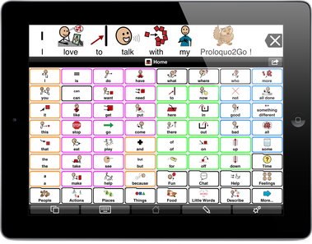
Tablet
Speech Generating Device (SGD)
iPad

Slide 5
Google Tools for Special Needs
Google Tools for Special Needs Training Video
Google Tools Information Sheet

Slide 6
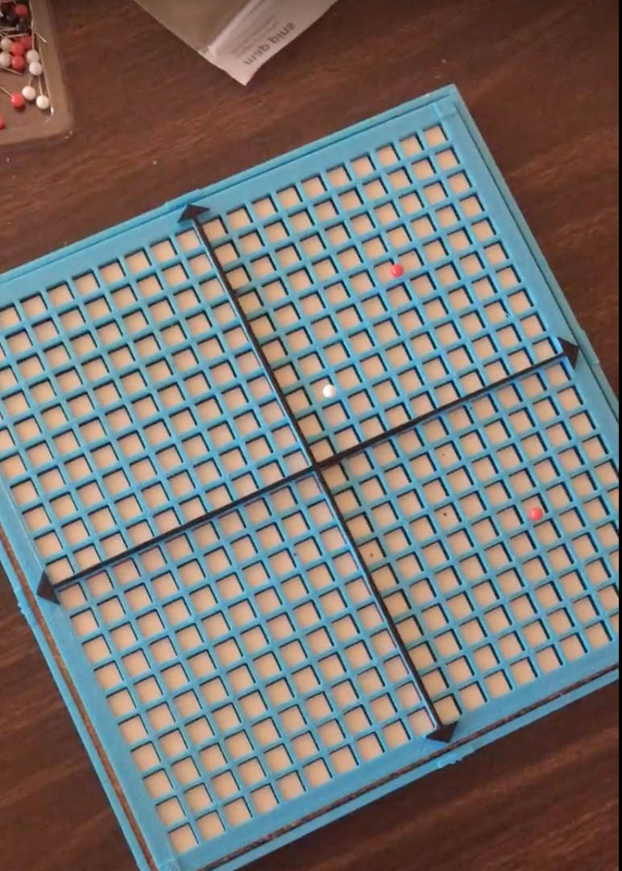
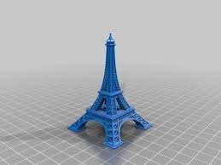
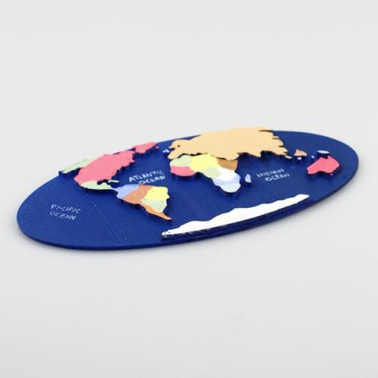
3D Objects/Printers
Notes:
Visually Impaired
Cognitive/Intellectual impairments-concept development
Tactile Learners
Creates interest in learning

Slide 7
Assistive Technology Survey

Slide 8
RESOURCES

Slide 9
Websites
American Printing House for the Blind
http://www.aph.org/
Google Tools for Special Needs
https://docs.google.com/document/d/1n4BWpDIDtjdWT5-vdVF0w5wsR6CitJxQeCnjlsFQl9s/edit
Harris-Hillman Technology Lab
http://harris-hillmantechlab.weebly.com/
Technology Access Center
http://tacnashville.org/

Slide 10
Dr. Robbie Hampton
Robbie.Hampton@lipscomb.edu
615-966-6171

