Slide 1
Be Future Ready
2017 National Education Technology Plan (NETP)
https://tech.ed.gov/files/2017/01/NETP17.pdf
Karen Marklein, Program Director, Ayers Institute
Ignite, 2017

Slide 2
What does Wayne Gretzky have to do with this?
“A good hockey player plays where the puck is. A great hockey player plays where the puck is going to be.”
How are you anticipating where the “puck” will be?
Notes:
Hockey image

Slide 3
Letter from the Director
Joseph South, Office of Educational Technology
One-year update
  5-year no longer current enough
Most classrooms have broadband
Lower price devices
Librarian and teacher leaders expanded role
Responsible digital citizenship
Focus on technology in pre-service

Slide 4
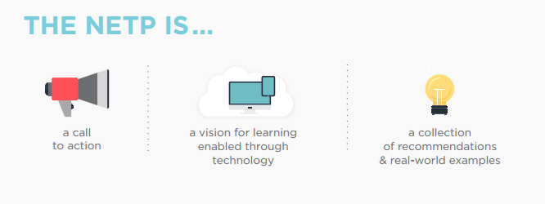
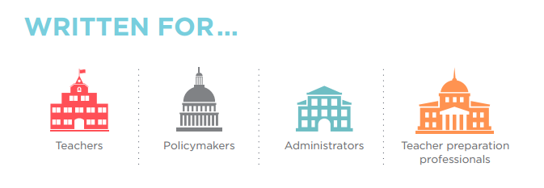

Slide 5

Why is this important?

Slide 6
Focus points of NETP
Learning—Engaging and empowering learning
Teaching—Effective teaching
Leading—Creating a culture for innovation
Assessing—Measuring learning
Enabling—Access and effective use

Slide 7
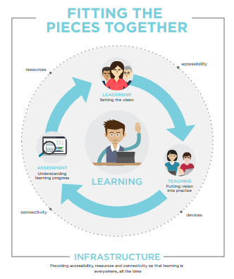

Slide 8
Equity AND Accessibility
Equity in education means increasing all students’ access to educational opportunities with a focus on closing achievement gaps and removing barriers that students face
Accessibility refers to the design of apps, devices, materials, and environments that support and enable access to content and educational activities for all learners.
Notes:
based on their race, ethnicity, or national origin; sex; sexual orientation or gender identity or expression; disability; English language ability; religion; socioeconomic status; or geographical location.
In addition to enabling students with disabilities to use content and participate in activities, the concepts also apply to accommodating the individual learning needs of students.

Slide 9
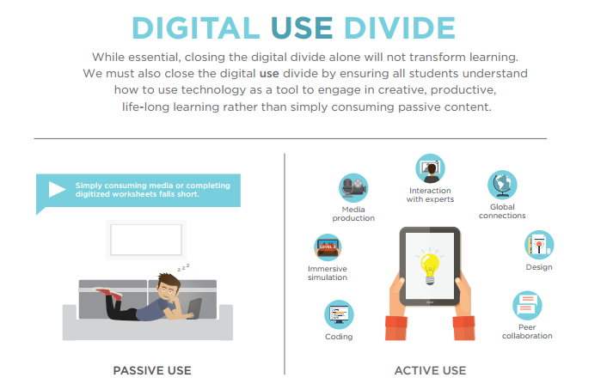
No longer a digital divide…

Slide 10
Future-ready learning: Recommendations
develop and implement learning resources that embody the flexibility and power of technology to create equitable and accessible learning ecosystems that make learning possible everywhere and all the time for all students
take inventory of and align all learning technology resources to intended educational outcomes

Slide 11
Future-ready teaching:
Recommendations
Provide educators with professional learning experiences powered by technology to increase their digital literacy and enable them to create compelling learning activities that improve learning and teaching, assessment, and instructional practices
Use technology to provide all learners with online access to effective teaching and better learning opportunities with options in places where they are not otherwise available

Slide 12
Future-ready leading: Recommendations
Set a vision for the use of technology to enable learning for students, educators, families, technology professionals, community groups, cultural institutions, and other interested parties
Develop clear communities of practice for education leaders at all levels that act as a hub for setting vision, understanding research, and sharing practices

Slide 13
Future-ready assessing: Recommendations
design, develop, and implement learning dashboards, response systems, and communication pathways that provide timely and actionable feedback about student learning to improve achievement and instructional practices
explore how embedded assessment technologies such as simulations, collaboration environments, virtual worlds, games, and cognitive tutors can be used to engage and motivate learners while assessing complex skills

Slide 14
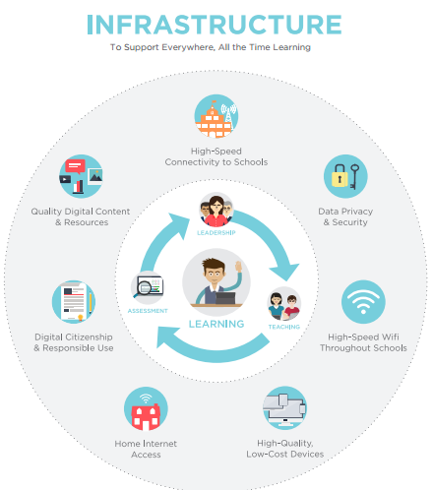

Slide 15
Reflection
How could these NETP recommendations improve your own technology plan?
What conversations do you need to have and with whom?

