Slide 1
Fostering Collaborative Professionalism
Please sit in groups. Thanks.
Dr. Margie Johnson
MNPS Collaborative Inquiry Coordinator
September 13, 2017

Slide 2
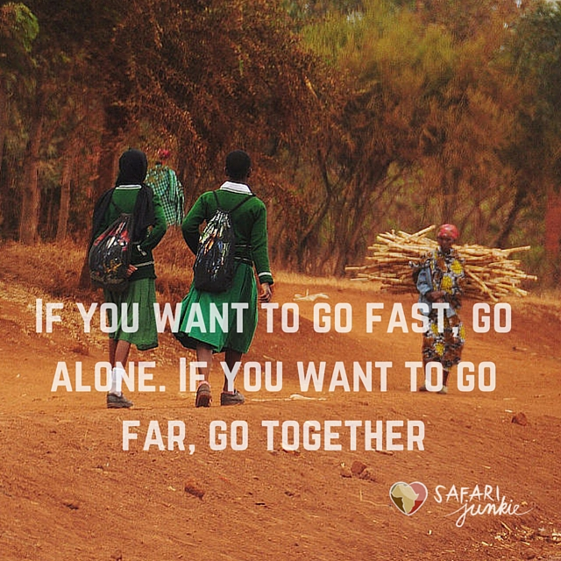

Slide 3

Shift the Narrative
”From ‘fixing the teacher’ to collaborative expertise”
--J. Hattie, 2015, p. 5

Slide 4
Our purpose as leaders is to foster a culture of collaboration to
support student success.

Slide 5

Today’s Outcomes
Provide an overview of district’s journey toward implementing collaborative inquiry.
Share lessons learned (i.e. tips and tricks) for implementing collaborative inquiry.
Wilkerson & Johnson, 2017

Slide 6
Collaborative Inquiry
What comes to mind when you think of the term collaborative inquiry?

Slide 7
Collaborative Inquiry
Collaborative Inquiry is stakeholders working together to uncover and understand problems and to test out solutions together through rigorous use of data and reflective dialogue.
Assumption: This process unleashes the resourcefulness of stakeholders to continuously improve learning.
N. Love, K.E. Stiles, S. Mundy, and K.DiRanna, 2008

Slide 8


Partners in a common cause
TN partner 2014-2016
Data use workshops
Teacher Data Use Survey
Evaluation capacity building
School data teams
Principals
Data coaches
Teachers
Central office staff
Pilot schools
Removing barriers to effective data use
Collaborative Inquiry
Notes:
REL AP partnered with us with developing a common language and data literacy and analysis.

Slide 9
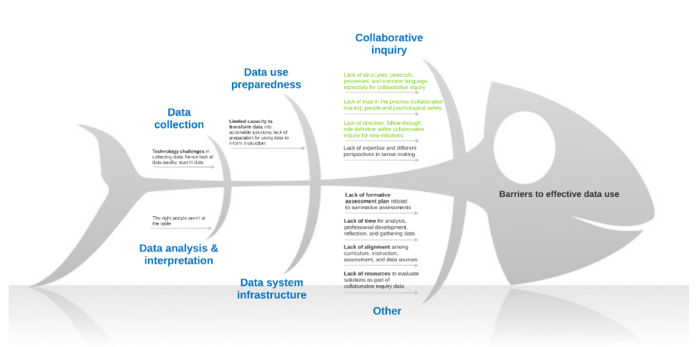
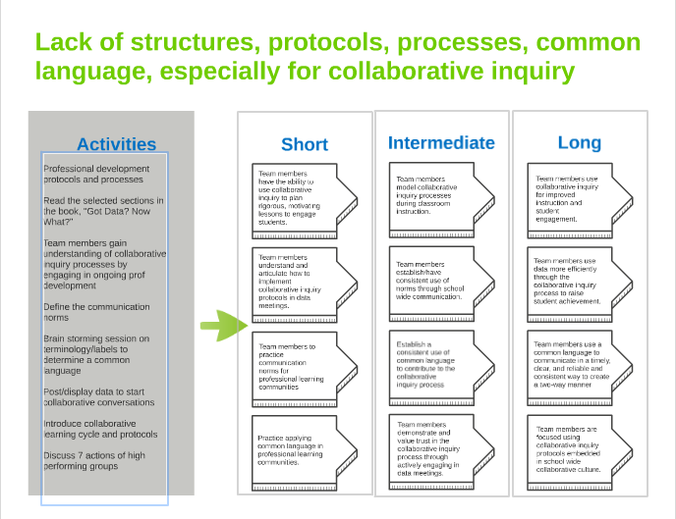
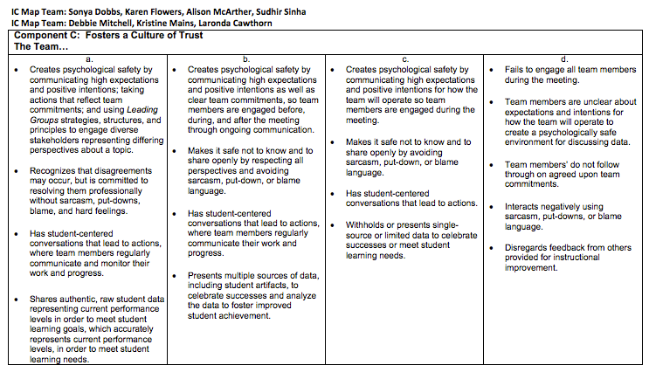
Developing a Common Language
Fishbone: Root Cause Analysis
Logic Models: Intended Outcomes
Tool: Teacher Data Use Survey
Innovation Configuration Map: Practices

Slide 10
MNPS IC Map for Collaborative Inquiry

Slide 11
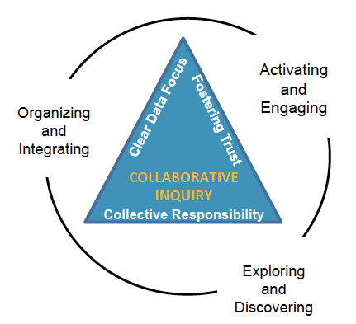

MNPS Collaborative Inquiry
Collaborative Inquiry is a data-based team process that consciously uses the collaborative learning cycle and the qualities of effective groups (fostering a culture of trust, maintaining a clear focus, taking collective responsibility and data-informed decision-making).
MNPS Collaborative Inquiry Community of Practice

Slide 12
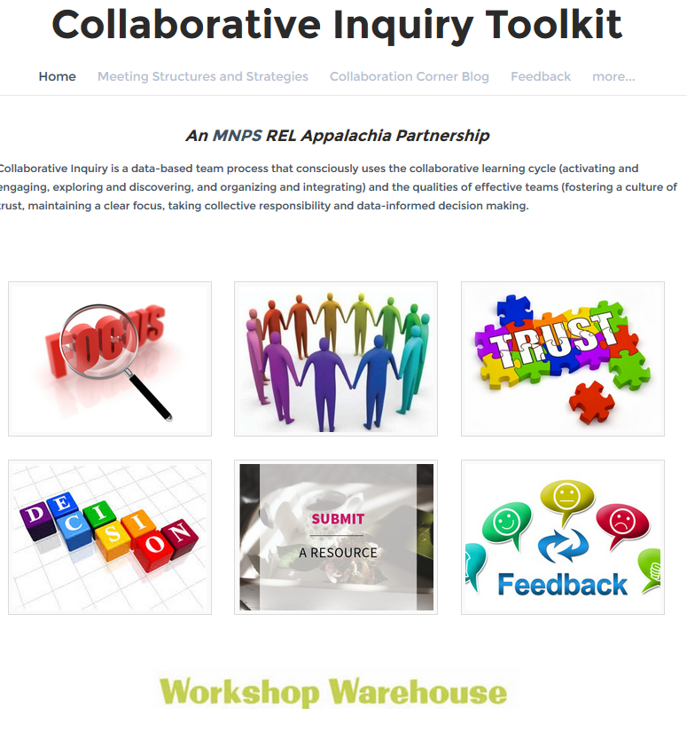


MNPS Collaborative Inquiry Toolkit
www.mnpscollaboration.org

Slide 13
Reflection
What might be some ideas you take from this session to implement in your organization and/or share with others?

Slide 14
Contact Information
Margie L. Johnson, Ed.D.
margie.johnson@mnps.org
Twitter: @MargieLJohnson3
www.mnpscollaboration.org
Notes:
Margie & Jenny
Q&A
Any questions?

Slide 15
References
Hattie, J. (Fall 2015). What works in education: The politics of collaborative expertise. London, UK: Pearson. Retrieved from https://www.pearson.com/content/dam/corporate/global/pearson-dot-com/files/hattie/150526_ExpertiseWEB_V1.pdf
Wilkerson, S. & Johnson, M. (2017 April). Partners in a common cause. The Learning Professional, 38(2). https://learningforward.org/publications/jsd/jsd-blog/jsd/2017/04/10/the-learning-professional-april-2017

