Slide 1
One Note for Blended Learning
Tim Carey
Instructional Technology Coach
Rutherford County Schools
@tcarey98

Slide 2

Objectives
Define Blended Learning
Define One Note and how it can be used
Establish a starting point for using One Note with students
Provide resources

Slide 3
Turn and Talk
How are you currently engaging students with technology in your classroom/school/district?

Slide 4
What is Blended Learning?
By integrating both classroom and online learning, blended learning models create the opportunity to provide tailored instruction at multiple levels, shifting the time, place, and pace of learning to fit student needs.
Personalized Learning: Task Force Report
TDOE November 2016

Slide 5
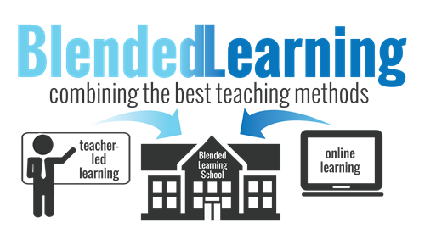

Slide 6
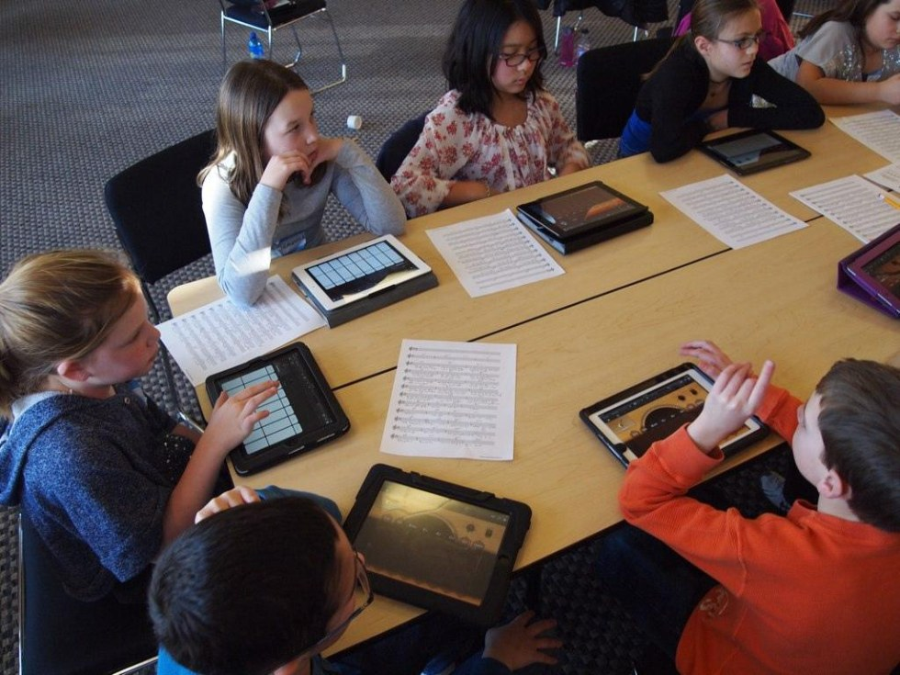
Why Blended Learning Important?
It gives students more opportunities to experience class content.
It gives teachers more opportunity to focus on students in small group.
Learning allows students to learn at their own pace with their own voice.

Slide 7
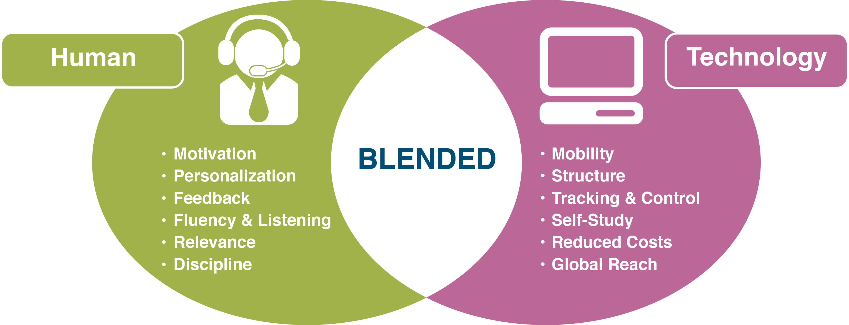

Slide 8
Turn and Talk
What kindergarten strategy can we use introduce blended learning to our classrooms?

Slide 9








Beginning Blended Learning
Choose a Learning Management System (LMS) or platform that suits your classroom needs or environment.
Gather and post content (Links, Handouts, Videos)
Develop a method for providing feedback.

Slide 10

Why should I choose One Note?
One Note is an online notebook.
Start simple, scale up.

Slide 11
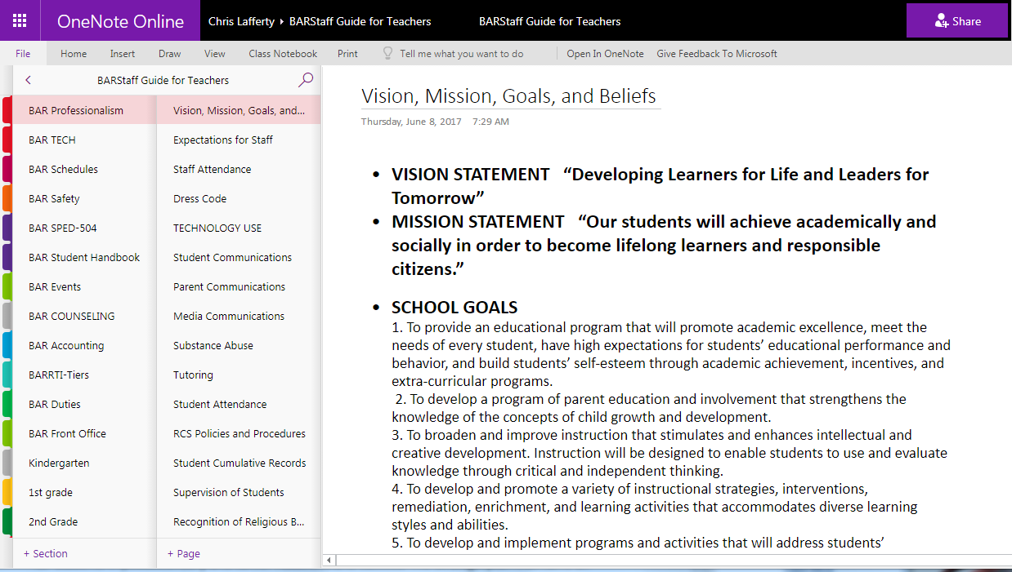

Slide 12
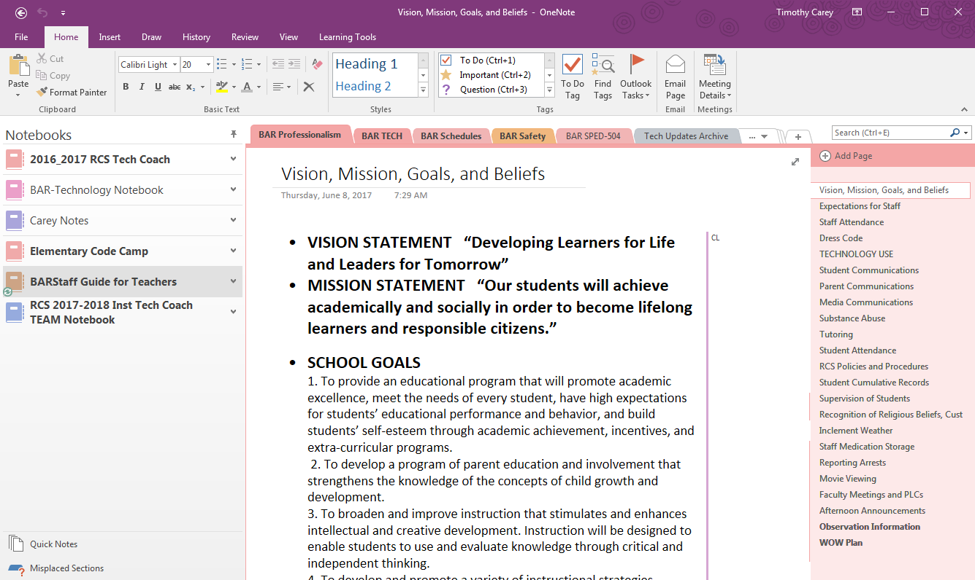

Slide 13
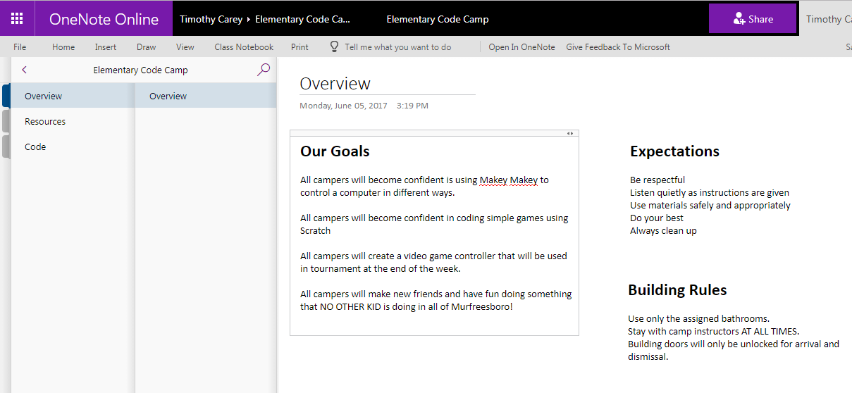

Slide 14
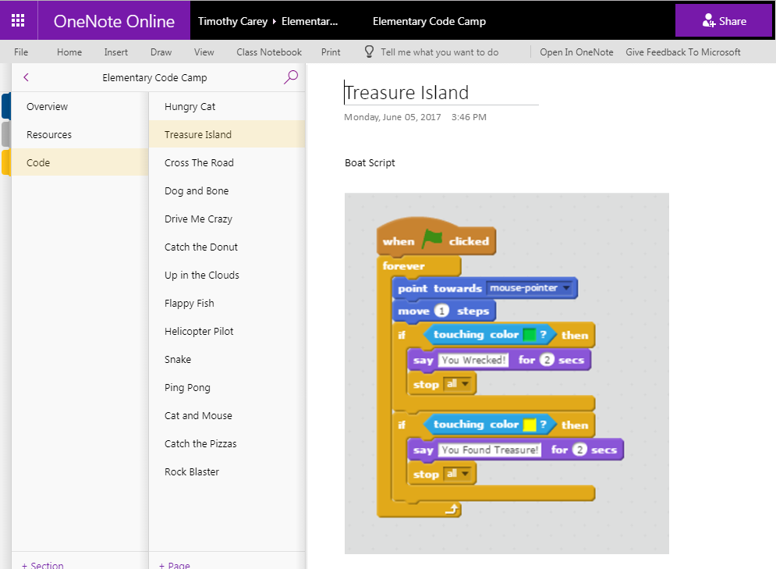

Slide 15
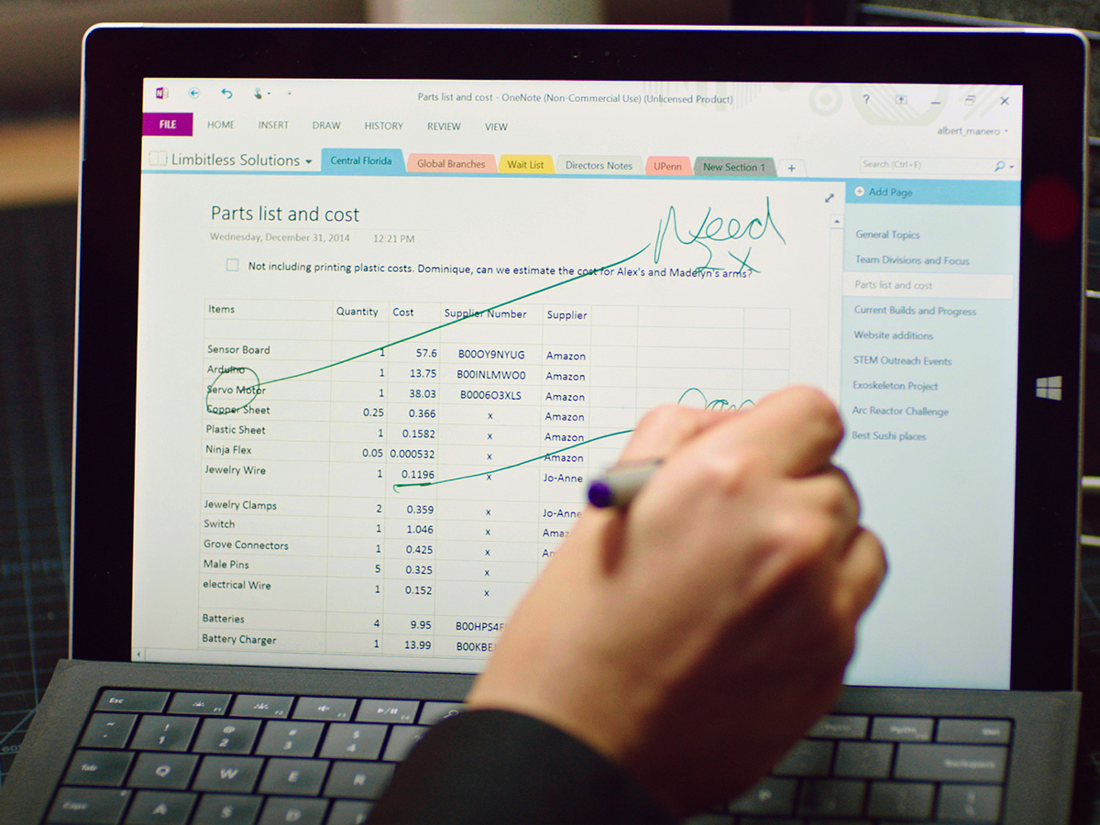
Using One Note with students
Device independent.
Supports multiple media types.
Integrated into multiple Microsoft products. (MS Office, Outlook, Office Mix Snip)
Can be accessed and updated from an app

Slide 16
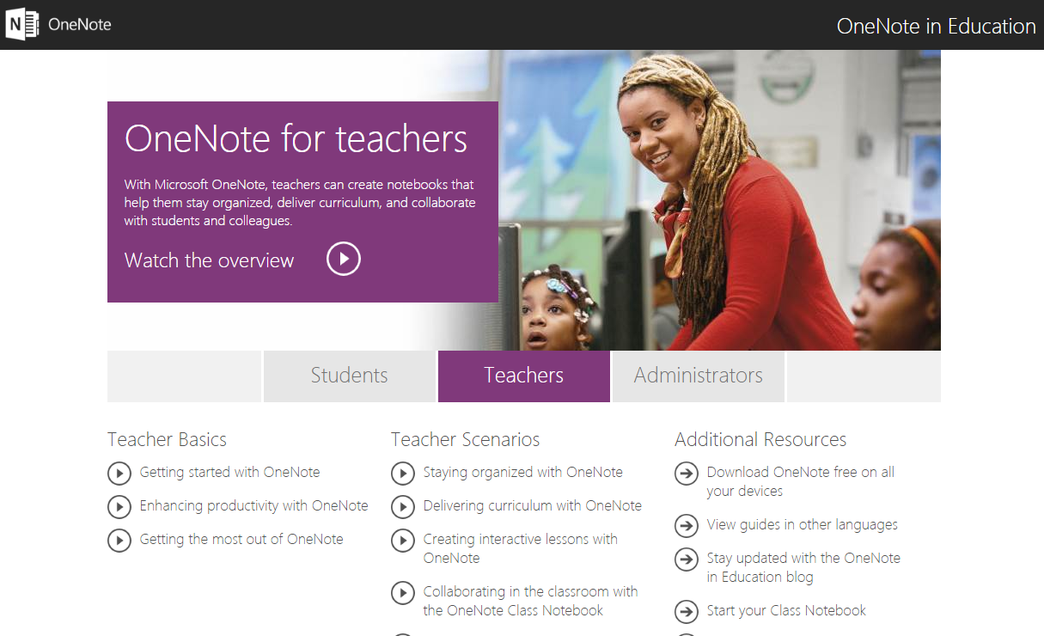
www.onenoteforteachers.com

Slide 17
Turn and Talk
How can you integrate this in your classroom?
What hurdles do you anticipate while trying to integrate this with your students/PLC?

Slide 18
Additional Resources
https://www.youtube.com/watch?v=auzwH1mK2TY&t=22s
https://www.youtube.com/watch?v=Mb2d8E1dZjY&t=81s
https://www.onenoteforteachers.com/

