Slide 1
Supporting Academic literacy: English language learners beyond the ESL classroom
Amy V. Shifflett
Lipscomb University
2017

Slide 2
Introduction
Purpose: Strategies for assisting English language learners (ELLs) with academic literacy, reading skills
Introductions: your name & department/ discipline

Slide 3
Introduction
What are some challenges you have encountered with English language learners in your courses?
Short Discussion

Slide 4

Assumptions
English language learners (ELLs) have high speaking/ listening skills; lower academic reading proficiency (NSCC)
Reading skills: basis for college success – all disciplines
Reading-heavy courses - challenge to ELLs’ academic success & retention
Figure. 1. Reading is basis for education. Retrieved from acer.org/ozpisa/.

Slide 5

What are some common themes/ issues?
Language – Written & Spoken
Increased text complexity (whole text level)
Academic v. everyday language structures (sentence-level)
Academic, disciplinary vocabulary (word-level)
Figure 1. English cloud: Words about language learning. Adapted from Vector FX. Retrieved from https://www.shutterstock.com/image-vector/english-cloud-words-about-language-learning-288511997.
Notes:
Copy formatting is weird…Go with something straightforward.
Also I spaced out you copy to make it read better.
Use the Whole Slide!
What are some Common Problems for ELL Students?

Slide 6
Problem #1
Increased Text Complexity: Academic, expository texts are often a departure from narrative texts in earlier learning.
(Whole-text level)
Notes:
Spaced out your slide to better use the space.
This language is a little confusing to me…would it help to bullet out
Academic
Expository texts
A departure from narrative texts in earlier learning
What does whole-text level mean? The books themselves?

Slide 7
Activity #1
Read the text sample.
Discuss: what aspects of the text might be hard for English Language Learners (ELLs)? Why?
Increased text complexity in academic setting (whole-text level)
Notes:
Spaced out the text to read larger

Slide 8
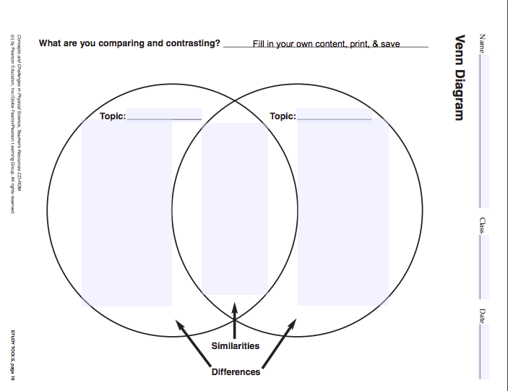
Problem #1: Increased Text Complexity
Strategy A: Supplement texts
  Graphic organizers
  Timelines
  Visual images
  (Schleppegrell, M. J., Achugar, M., & OteÍza, T. , 2004).
  Figure 1. Venn Diagram. Adapted from Teachervision.com. Retrieved from https://www.teachervision.com/graphic-organizer/venn-diagram.
RESOURCES:
https://www.teachervision.com/
  downloadable graphic organizer templates (some fillable)
  See example PDF
Google Images
  Easy to cite sources
Notes:
Is there another visual example of one of the other bullets?

Slide 9

Problem #1: Increased Text Complexity
Strategy A: Supplement texts
  Explanations of ideas and events
  Illustrative narratives
  Biographies
  (Schleppegrell et al., 2004)
Figure 1. Biographies and narratives. Retrieved from www.study.com
Notes:
Kill the flower bg…your content image will pop more without the distraction behind it.

Slide 10
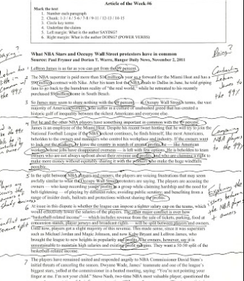
Problem #1: Increased Text Complexity
Strategy A: Supplement texts
Outlining, chunking
    K. Sorenson & C. Matthews, personal communication, January 27, 2017
Visual Hierarchy & headings
Differentiated topic & details
(Hadaway, N., Vardell, S. M., & Young, T. A., 2002)
Figure 1. Annotated article. By Court Allam, 2012, retrieved from http://iteachicoachiblog.blogspot.com/2012/06/five-simple-close-reading-strategies.html.
Notes:
Hard to understand this visual without the context….looks a little busy but that may be the point

Slide 11
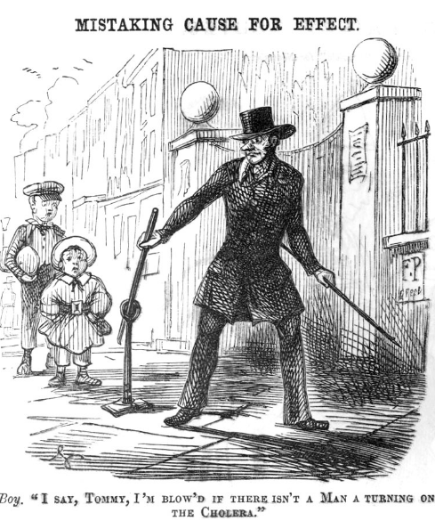
Problem #1: Increased Text Complexity
      General literacy practices:
      specialized to discipline
    Paraphrasing
    Summarizing
    Restating main idea
    Predict
    Inferring author’s perspective
    (Vacca, R.T., Vacca, J.L., & Mraz, M.,, 2014)
    Figure 1. Mistaking cause for effect. Adapted Punch Magazine, 1849, retrieved from https://commons.wikimedia.org/wiki/File:Mistaking_Cause_for_Effect_-_Turning_on_the_Cholera.jpg.
Example: historical text – focus on language of causality, turning points, point of view

Slide 12

Problem #1: Increased Text Complexity
Strategy B: Encourage multiple readings, varying purpose
1st reading -> alongside audio book
2nd reading -> annotations, questions about meaning
3rd reading -> dictionary, research
    K. Sorenson & C. Matthews, personal communication, January 27, 2017
Figure 1. Woman with unhappy expression studying. Adapted from istockphoto.com, by John Sommer, 2014, retrieved from http://www.istockphoto.com/photo/woman-with-unhappy-expression-studying-gm465484817-33534162.
  Less time looking up vocabulary and minutiae
  Better holistic comprehension
Notes:
Highlight your key takeaway…I provided an example...you can do this on several slides

Slide 13

Problem #1: Increased Text Complexity
  Strategy C: Introduce audio version of text
    Textbooks, lectures, research
    Listening while reading reinforces association: sounds & written word
    Apprehend content using more than one language skill (reading only)
    K. Sorenson & C. Matthews, personal communication, January 27, 2017
          RESOURCES
          Naturalreaders.com
          NSCC Campus bookstore –
          Electronic text + screen reader app
          Amazon’s Whispersync = Audio + Kindle
          NSCC Library – Academic OneFile
        Figure 1. Listening + Reading = Ingles TOP! Adapted from discussion board post
        by Tamar Judson, 2014, retrieved from
        https://www.duolingo.com/comment/2594588.

Slide 14
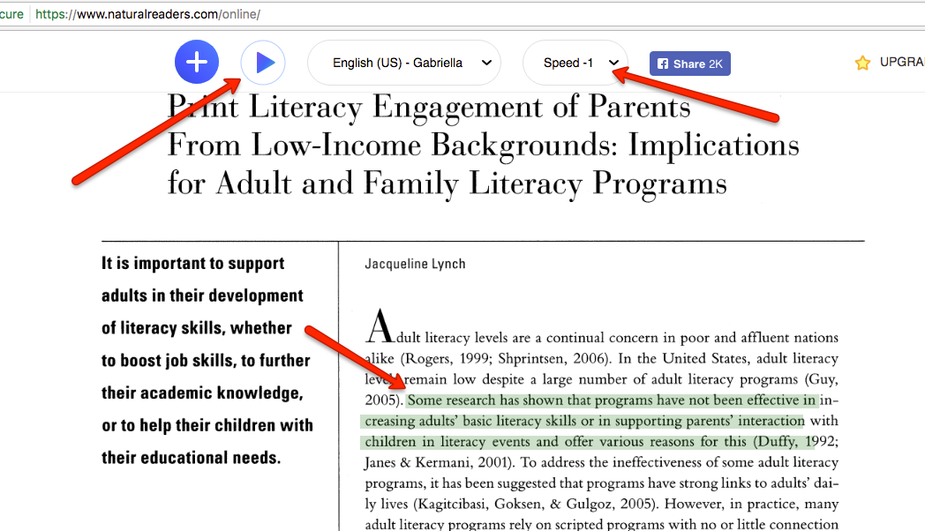
Problem #1: Increased Text Complexity

Slide 15
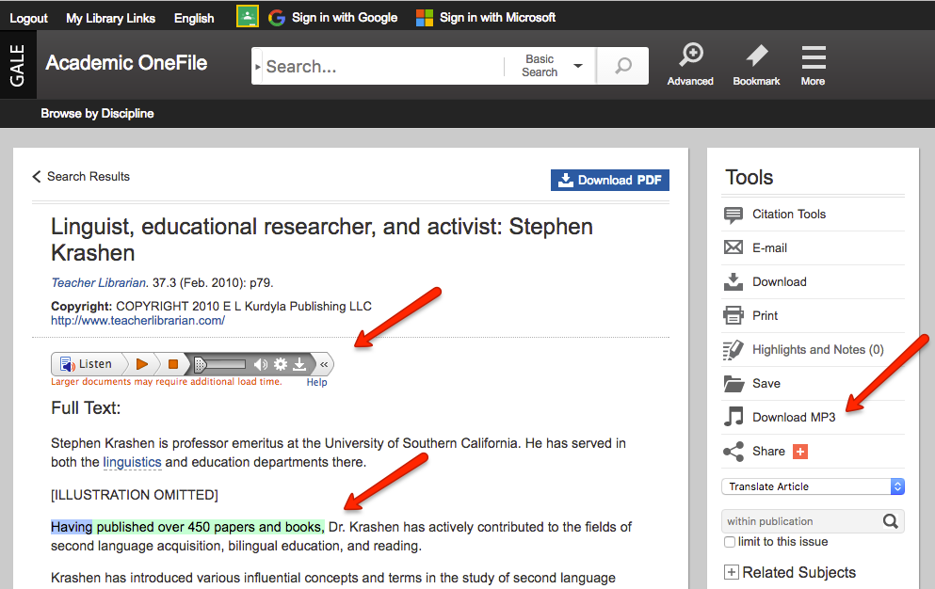
Problem #1: Increased Text Complexity

Slide 16
Problem #2
Academic language structures are different than English acquired initially
(Sentence level)

Slide 17
Activity #2
See highlighted sentence in paragraph 3. Notice the grammar.
Academic v. everyday language structures (sentence-level)
Notes:
Enlarged and spaced copy

Slide 18
Activity #2
Paragraph #3
“Therefore, it was the contention that what adults learn about literacy is shaped by the context of their social and cultural community” (Lynch, J., 2009).
Academic v. everyday language structures (sentence-level)
  ^{Complex adjective clause}
  Difficulty locating main verb in sentence
  ^{"it was + nominal (contention)}
  Passive voice inside adjective clause, but main verb is active
  Language of causal reasoning, connecting ideas ^{(therefore)}
Closer to sentence structures studied previously
The research argued that the context of social and cultural community shapes what adults learn about literacy.
Notes:
Can you organize this page visually to show the take away?

Slide 19
Problem #2: Academic Language Structure
Strategy A: Scaffold, Recast, Model - Instructions
“Comprehensible input” - Without understandable task instructions or presentation of content, many language learners may not acquire the process or content. (Kareva, V. & Echevarria, J., 2013)
Don’t assume that regular classroom routines and learning strategies are familiar to ELLs. (Kareva, V. & Echevarria, J., 2013)

Slide 20
Problem #2: Academic Language Structure
Complex assignments: written & oral input
Recast complex text: lectures & instructions
Deliver instructions in steps
Examples of final product
Model process or tasks
(Kareva, V. & Echevarria, J., 2013)
Number figures and logo adapted from tes.com. Copyright 2017 by TES.
Notes:
This visual is somewhat confusing to me…I understand you are trying to show the technique by using it...but maybe I need the context

Slide 21
Instruction Delivery
      Teacher gives oral review of content discussed previously.
      Teacher asks (verbally) series of questions about previous content.
      Several students participate.
      Teacher reviews key points.
      Teacher hands out graphic organizer for students to complete, using ideas discussed.
      (Echevarria, J., Vogt, M., & Short, D.J., 2013)
What could go wrong?
Notes:
What if you did this as a flow? 1.->2.->3. and repeat for next slide

Slide 22
Instruction Delivery
Teacher writes on board:
  Review notes from ___ .
  Use notes to answer 5 questions (also written on board)
Students write answers, working in pairs: fluent + lesser English proficiency
Teacher checks for accuracy; feedback
Teacher introduces graphic organizer, models first entry, explains purpose
Graphic organizers: students incorporate info from 5 questions
Teacher concept-checks understanding
      (Echevarria, J., Vogt, M., & Short, D.J., 2013)
Revised Lesson

Slide 23

Problem #2: Academic Language Structure
    Strategy B: Encourage reading & specializing “in chunks”
      Jigsaw classroom
      (Aronson, E., 2017)
      Study groups
      Group member roles, leaders
      Give opportunities to express meaning in students’ own words
      (L. Longwood, personal communication, October 5, 2016)
      Specific task with defined roles → readers more readily dive into the content
      (K. Sorenson & C. Matthews, personal communication, January 27, 2017)
    RESOURCE: https://www.jigsaw.org/
    Figure 1. Jigsaw Classroom logo. Adapted from The Jigsaw Classroom by Elliot Aronson, 2017, Retrieved from https://www.jigsaw.org/. Copyright 2017 by Social Psychology Network.
Notes:
Enlarge this font

Slide 24
Problem #1: Increased Text Complexity
    RESEARCH
    Close-reading practices that help internalize skills provide tools to help students how to comprehend increasingly more complex academic texts, not just demonstrate comprehension of a given text (Fang & Schleppegrell, 2010).
    Discussion of specific text chunks activates contextual knowledge and collectively strengthens comprehension of subsequent texts (Fisher, Frey, & Lapp, 2012).

Slide 25
Problem #3
Academic vocabulary takes on different characteristics than everyday terms, a challenge for ELLs (word level)

Slide 26
Activity #3
Find a vocabulary word in the reading sample that an ELL may struggle with.
Write a new sentence using the vocabulary word within the context your content area.
Example: The contention was whether the students had understood the instructions.
Academic, disciplinary vocabulary (word-level)

Slide 27
Problem #3: Academic v. Everyday Vocabulary
    Vocabulary – Text Sample
    P. 3 – “it was the contention”
    P. 3 “communicative purposes”
    P. 4 “temporal excursion”
    P. 5 “provision of reading materials”
    P. 5 “emergent literacy practices”
    (Lynch, J., 2009)
    Potential Pitfall
    Nominalization
      To contend → contention
      To provide → provision
    Unexpected part of speech
      To communicate → communicative
      To emerge → emergent
    Higher tier vocabulary:
      excursion (escape, trip) used figuratively
      Temporal (temporary) relating to time
Notes:
Adjusted spacing and font sizes

Slide 28
Problem #3: Academic v. Everyday Vocabulary
Academic
Mostly written, not oral texts
Low-frequency, specialized
Mostly Graeco-Latin origins
Words made from smaller word parts (affixes, etc.)
Native English speakers → 5 years + 13 years (K-12) learning academic language
ELLs – catch-up is substantial
(Cummins, 2012)
Everyday, basic
  High-frequency vocab
  Shorter words, less “meaningful parts”
  Often Anglo-Saxon in origin
  ELLs proficient in ~2 years of US residency
  Many NSCC ELLs are very fluent (speaking/listening)
  (Cummins, 2012)

Slide 29
Problem #3: Academic v. Everyday Vocabulary
Tier 1 Word | Tier 2 Word | Tier 3 Word
house | abode | habitat
find | search | investigate
Tier 1: everyday, basic vocabulary – scaffold toward higher tiers
Tier 2: provides precision, specificity in describing known concepts
  Multiple meanings across content areas (table, table, table)
  Multiple forms of same word (search, researcher, to search)
  Transition words (furthermore, therefore, so, within)
Tier 3: academic – specific to content areas, includes cognates
(Minaya-Rowe, 2012)

Slide 30

Problem #3: Academic v. Everyday Vocabulary
    Strategy A: Build Context
Activate prior knowledge
Build background knowledge
(Cummins, 2012)
    Figure 1. International Students Studying. Adapted from article on College Factual by Ryan Tetzlaff, 2017, retrieved from http://parents.collegefactual.com/blog/how-international-students-affect-the-us-education-system.

Slide 31

Problem #3: Academic v. Everyday Vocabulary
      Strategy A: Build Context
      Directly teach & refer back to critical terms
      Concentrate on key concepts (less is more)
      Connect vocab with student experience
      Provide active practice through listening, speaking, reading & writing
      Cross-reference to other content areas
    (Minaya-Rowe, L., 2012)
    Figure 1. Cartoon woman balancing books. Adapted from Teaching Resources by Laura Candler, retrieved from http://www.lauracandler.com/strategies/balancedlit.php

Slide 32
Problem #3: Academic v. Everyday Vocabulary
RESEARCH
    Provide scaffolding of disciplinary knowledge and explicit instruction of the usage of its academic language, elucidating register (Gebhard, 2010).
    Scaffolds include temporary supports that help learners complete/perform tasks at an academically higher level (Cummins, J., 2012).
    Asking students to personalize vocabulary in their sentences makes new terms “stick” (L. Longwood, personal communication, October 5, 2016).

Slide 33

Problem #3: Academic v. Everyday Vocabulary
    Strategy B: Understand existing lexicons, offer resources
      ELL students in college may have ~4500 words, while native speakers have ~30,000 words
      (K. Sorenson and C. Matthews, personal communication, January 27, 2017; newgeneralservicelist.org/.
      Figure 1. International Students Graduate. Retrieved from https://share.america.gov/.)

Slide 34
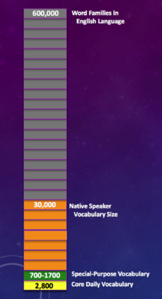
Problem #3: Academic v. Everyday Vocabulary
Word Lists
    oxfordlearnersdictionaries.com/us/wordlist/english/academic/
    newgeneralservicelist.org/
    newacademicwordlist.org
      Quizlet flashcards/ definitions
        Downloadable word lists
        Differentiates academic & everyday words
Academic Word Families
    victoria.ac.nz/lals/resources/academicwordlist/sublists
ELL Dictionaries
  learnersdictionary.com/
  oxfordlearnersdictionaries.com/us/
    Figure 1. Vocabularies. Adapted from graphic by Browne, C., Culligan, B. & Phillips, J., 2013, Browe C. & Culligan B., 2015, retrieved from newgeneralservicelist.org/.

Slide 35
Problem #3: Academic v. Everyday Vocabulary
Strategy C: Anticipate difficulties,
Offer resources
Example: Table
    Affixes (ed, ment, re-, ous, a- )
    Multiple meanings
    Grammatical variations
    False cognates
    Root words
    Synonyms
    Homophones (vary, very)
    Idiomatic usage
(Minaya-Rowe, L., 2012)
Table (n.) – piece of furniture.
To table (something) (v.) – to postpone discussing or resolving an issue.
Table (n.) – visual chart used in scientific texts.
(Minaya-Rowe, L., 2012)

Slide 36
“Language is the process of free creation; its laws and principles are fixed, but the manner in which the principles of generation are used is free and infinitely varied.”
- Noam Chomsky

Slide 37
Please participate: feedback survey
Print or online
Surveymonkey.com/r/NTNVT28

Slide 38
THANK YOU!
Dr. Julie Williams (NSCC)
Dr. Jeanne Fain (Lipscomb)
Dr. Lance Forman (Lipscomb)
Connie Matthews(NSCC)
Kathy Sorenson (NSCC)
Leda Longwood (NSCC)
Wendy Dierberger (NSCC)
Krista Mazza Carter (Trevecca & VSCC)
Christina Shaffer (NSCC)
Matt Blum
My ESL students
WITH SPECIAL THANKS TO….

Slide 39
References
    Aronson, E. (2017). Jigsaw classroom. Retrieved from https://www.jigsaw.org/
Cummins, J. (2012). Whole-School Approaches to Academic Language Proficiency Among English learners. In M. Calderon. (Ed.) Breaking through: Effective instruction & assessment for reaching English learners. (63-85). Bloomington, IN: Solution Tree Press.
Echevarria, J., Vogt, M., & Short, D. (2013). Making content comprehensible for English learners: the SIOP model. Boston: Pearson.
Fang, Z., & Schleppegrell, M. J. (2010). Disciplinary literacies across content areas: supporting secondary reading through functional language analysis: by making discipline-specific ways of using language explicit, teachers can help adolescents better engage with school knowledge and more effectively develop disciplinary literacies across academic content areas. Journal of Adolescent & Adult Literacy, 53(7), 587+. Retrieved from http://luprox.lipscomb.edu/login?url=http://go.galegroup.com.vwproxy.lipscomb.edu/ps/i.do?p=LitRC&sw=w&u=tel_a_beaman&v=2.1&it=r&id=GALE%7CA224989403&asid=7a43281daf3d57ce998d69419b587ef8
Fisher, D., Frey, N., & Lapp, D. (2012). Teaching students to read like detectives: Comprehending, analyzing, and discussing text. Bloomington, IN: Solution Tree Press.
Gebhard, M. (2010). Teacher education in changing times: A systemic functional linguistics (SFL) perspective. TESOL Quarterly, 44(4), 797-803. Retrieved from http://www.jstor.org/stable/27896766
Hadaway, N., Vardell, S. M., & Young, T. A. (2002). Highlighting nonfiction literature: Literacy development and English language learners. The NERA Journal, 38(2), 16–22. Retrieved from http://www.gwinnett.k12.ga.us/HopkinsES/Alfonso_Web/ESOL%20Modification%20Research/ELL_fiction_books.pdf
    Lynch, J. (2009). Print literacy engagement of parents from low-income backgrounds: Implications for adult and family literacy programs. Journal of Adolescent & Adult Literacy, 52(6), 509-521. doi:101598/JAAL.52.6.5

Slide 40
References
    K. Sorenson & C. Matthews, personal communication, January 27, 2017.
Kareva, V. & Echevarria, J. (2013). Using the SIOP model for effective content teaching with second and foreign language learners. Journal of Education and Training Studies, 1(2). Retrieved from http://files.eric.ed.gov/fulltext/EJ1054872.pdf
      L. Longwood, personal communication, October 5, 2016.
Minaya-Rowe, L. (2012). Effective teaching for ELs and all students: Vocabulary, reading, and writing within all subjects. In M. Calderon. (Ed.) Breaking through: Effective instruction & assessment for reaching English learners. (107-126). Bloomington, IN: Solution Tree Press.
Schleppegrell, M. J., Achugar, M., & OteÍza, T. (2004). The grammar of history: Enhancing content‐based instruction through a functional Focus on language. TESOL Quarterly, 38(1), 67-93. doi:10.2307/3588259
Vacca, R., Vacca, J.A., & Mraz, M. (2014). Content area reading: Literacy and learning across the curriculum. Boston: Pearson.

Slide 41
References: Images
Allam, C. (2012). Annotated article [Digital image]. Retrieved from http://iteachicoachiblog.blogspot.com/2012/06/five-simple-close-reading-strategies.html
    Aronson, E. (2017). Jigsaw classroom logo [Digital image]. Retrieved from https://www.jigsaw.org/
Biographies and narratives [Digital image]. Retrieved from www.study.com
    Browne, C., Culligan, B. & Phillips, J. (2013). Vocabularies [Digital image]. Retrieved from newgeneralservicelist.org/
    Candler, L. Cartoon woman balancing books [Digital image]. Retrieved from http://www.lauracandler.com/strategies/balancedlit.php
International Students Graduate [Digital image]. Retrieved from https://share.america.gov/.
Judson, T. (2014). Listening + Reading = Ingles TOP! [Digital image]. Retrieved from https://www.duolingo.com/comment/2594588
Punch. (1849). Mistaking cause for effect [Digital image]. Punch Magazine, 17, p. 185. Retrieved from https://commons.wikimedia.org/wiki/File:Mistaking_Cause_for_Effect_-_Turning_on_the_Cholera.jpg
Reading is basis for education [Digital image]. Retrieved from acer.org/ozpisa/
Number figures and logo [Digital image]. Retrieved from tes.com
Tetzlaff, R. (2017). International Students Studying [Digital image]. College Factual. Retrieved from http://parents.collegefactual.com/blog/how-international-students-affect-the-us-education-system
  Sommer, J. (2014). Woman with unhappy expression studying [Digital image]. Retrieved from http://www.istockphoto.com/photo/woman-with-unhappy-expression-studying-gm465484817-33534162
  Vector FX. English cloud: Words about language learning [Digital image]. Retrieved from https://www.shutterstock.com/image-vector/english-cloud-words-about-language-learning-288511997
  Venn Diagram [Digital image]. Retrieved from https://www.teachervision.com/graphic-organizer/venn-diagram

