Slide 1
Reference Sources
Dictionary, Almanac, Encyclopedia, Atlas, Thesaurus

Slide 2
Conventions of Standard English
CCSS.ELA-Literacy.L.3.2g Consult reference materials, including beginning dictionaries, as needed to check and correct spellings.
Vocabulary Acquisition and Use
CCSS.ELA-Literacy.L.3.4d Use glossaries or beginning dictionaries, both print and digital, to determine or clarify the precise meaning of key words and phrases.
Common Core State Standards
Third Grade

Slide 3
Learning Goal
Students will be able to recognize an assortment of reference sources (dictionary, almanac, encyclopedia, atlas, thesaurus).

Slide 4
Essential Question
What are reference sources?

Slide 5
Objective
Determine the best reference source to use for information.

Slide 6
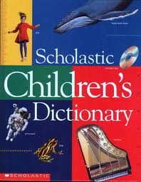
A dictionary is a book that gives pronunciations and definitions of words. The words are arranged alphabetically. The guide words at the top of each page show the first and last words on that page, so they will help you know if the word you want is on that page. The entry may also show synonyms and other forms of the word.
Dictionary

Slide 7

An almanac is published annually and has facts on many topics. Since the almanac is published every year the information is current. Almanacs contain important dates, weather, top news stories of the year, statistics on sports, facts about famous persons, world population figures, holidays, and other miscellaneous topics.
Almanac

Slide 8
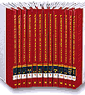
An Encyclopedia is a set of books which contains short articles about many topics; animals, presidents, countries, people, plants, and so much more. The articles are summaries with basic facts and information. The volumes are arranged in alphabetical order. If you need to find information about porcupines you would look in the P volume. Then you would use the guide words at the top of the pages to find porcupines. Key words help you know which volume contains the article you want to read. When trying to find a person, use the last name- George Washington.
Encyclopedia

Slide 9
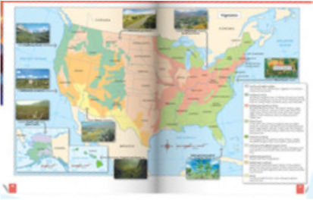
An Atlas is a book of maps, usually of the regions of the world. An atlas might contain both physical and political maps. Physical maps show the physical features of earth; mountains, bodies of water, deserts, plains, etc. Political maps show continents, countries and cities. To find a specific place in an atlas, the index is the best place to start. The index is at the back of the book and is arranged alphabetically. The table of contents, is at the front of the book and is arranged in sequential order. The atlas may also contain a map list.
Atlas

Slide 10
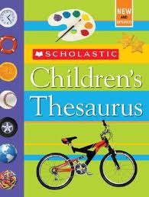
A thesaurus is a book of words with their synonyms and antonyms. Words are listed alphabetically. Use a thesaurus when you want to replace a word with a word of similar meaning.
Thesaurus

Slide 11





Which reference would you use to…
Learn more about the people of Canada?
Dictionary
Almanac
Encyclopedia
Atlas
Thesaurus

Slide 12
Which reference would you use to…
Look up how to pronounce the word signpost?
Dictionary
Almanac
Encyclopedia
Atlas
Thesaurus

Slide 13
Which reference would you use to…
Find other words that mean run?
Dictionary
Almanac
Encyclopedia
Atlas
Thesaurus

Slide 14
Which reference would you use to…
Find out the best fishing days for the year?
Dictionary
Almanac
Encyclopedia
Atlas
Thesaurus

Slide 15
Which reference would you use to…
Find the location of Italy?
Dictionary
Almanac
Encyclopedia
Atlas
Thesaurus

Slide 16
Dictionary
A book that gives definitions and pronunciations of words. Synonyms, antonyms and adding suffixes may also be included in the word entry.

Slide 17
Almanac
A book that is published each year and contains facts about many topics. There might be facts about countries, government, historical events, or sports. This book is revised every year so the information is very current.

Slide 18
Encyclopedia
A set of books that has articles about various topics. The short articles contain factual information and are arranged in alphabetical order.

Slide 19
Atlas
A collection of maps and geographical information. This book may contain maps that show political (countries, and cities) and physical features (mountains, deserts, oceans).

Slide 20
Thesaurus
A book of words with their synonyms and sometimes their antonyms.

Slide 21
Which reference would you use to…
Find the two states that border Florida?
Dictionary
Almanac
Encyclopedia
Atlas
Thesaurus

Slide 22
Which reference would you use to…
Find the meaning of the word sheen?
Dictionary
Almanac
Encyclopedia
Atlas
Thesaurus

Slide 23
Which reference would you use to…
Learn more about seaweed?
Dictionary
Almanac
Encyclopedia
Atlas
Thesaurus

Slide 24
Which reference would you use to…
Find out how to pronounce the word oxygen?
Dictionary
Almanac
Encyclopedia
Atlas
Thesaurus

Slide 25
Which reference would you use to…
Research energy?
Dictionary
Almanac
Encyclopedia
Atlas
Thesaurus

Slide 26
