Slide 1
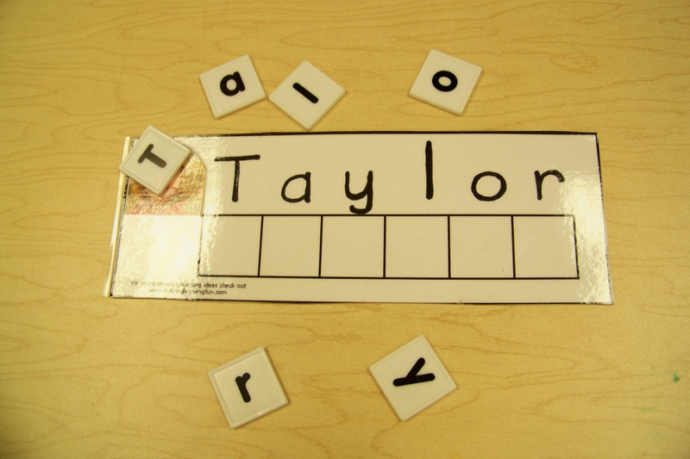
Building Student Names
This is meant to be a virtual option for the typical student name building that would occur in the classroom.
Copy and Paste the next slide several times to personalize it and write your student names. You can use this powerpoint during a small group or one-on-one virtual learning meeting to practice writing student names.
For more student engagement, you could have students write the names on paper as you build them together on the screen.
This Photo by Unknown Author is licensed under CC BY-NC-ND

Slide 2



























[Insert Name]
K
L
M
A
D
E
I
J
K
L
M
A
B
C
D
G
C
F
G
H
J
B
E
F
H
I
N
O
N
O
P
Q
X
P
Q
U
R
U
X
Z
R
S
S
T
T
W
W
Y
V
Y
Z
V

Slide 3
T a y l o r
[Insert student photo]
K
L
M
A
D
E
I
J
K
L
M
A
B
C
D
G
C
F
G
H
J
B
E
F
H
I
N
O
N
O
P
Q
X
P
Q
U
R
U
X
Z
R
S
S
T
T
W
W
Y
V
Y
Z
V

