Slide 1


FLOURISHING CLASSROOMS: FOSTERING JOY
Let’s establish some community!
Please introduce yourself in Chat: name, organization, & role.

Slide 2
THE AYERS INSTITUTE
“Be the bridge by which others cross to reach their goals.”
—Janet Ayers
A bridge…
Among educators
Between PK-12 and higher ed
From policy to practice

Slide 3
Our Mission
To support educators in improving student outcomes through proven professional learning and to incubate innovative instructional ideas and resources.
Ayers Institute for Learning & Innovation

Slide 4
Our Mission
To support educators…
Building capacity.
Ayers Institute for Learning & Innovation

Slide 5
Objectives for this Session
We will apply brain science and intentional pedagogical strategies to cultivate joyful learning environments where students engage deeply, grow purposefully, and truly flourish.

Slide 6
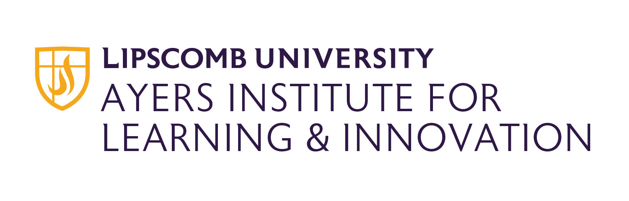
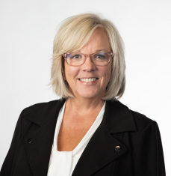
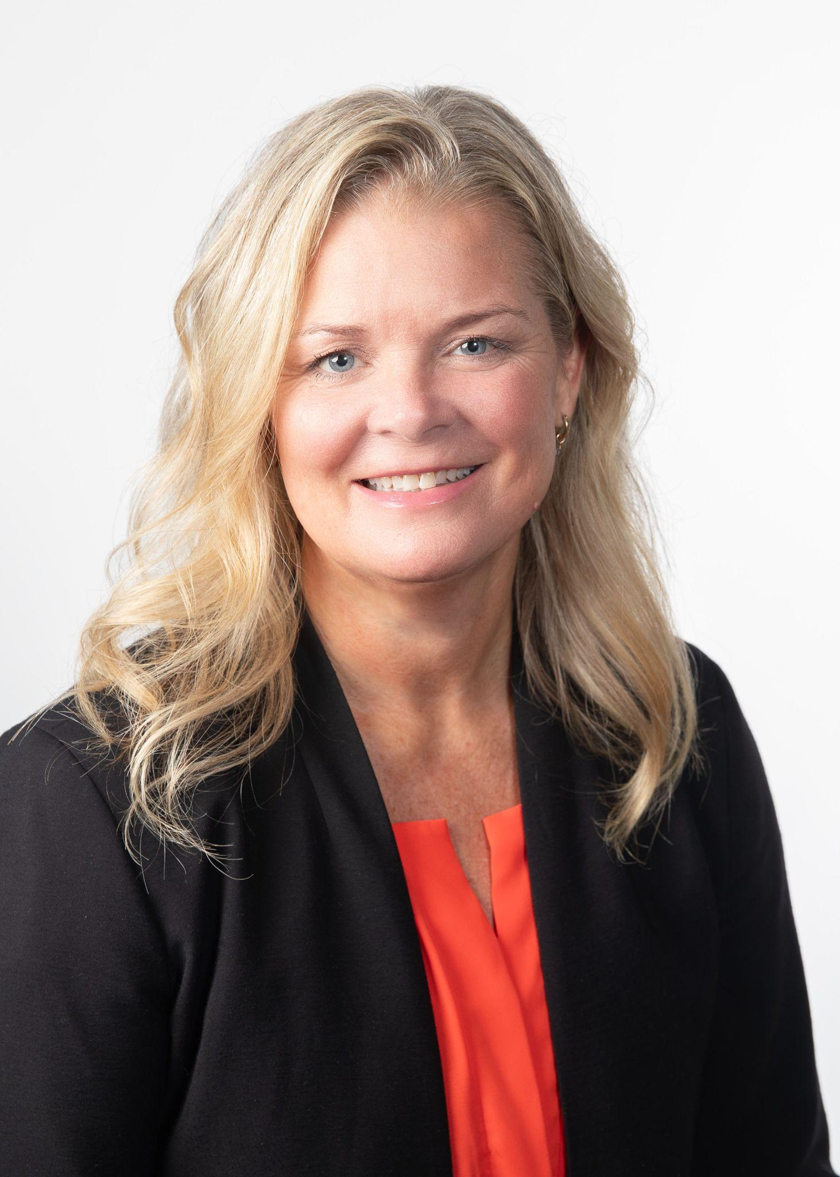
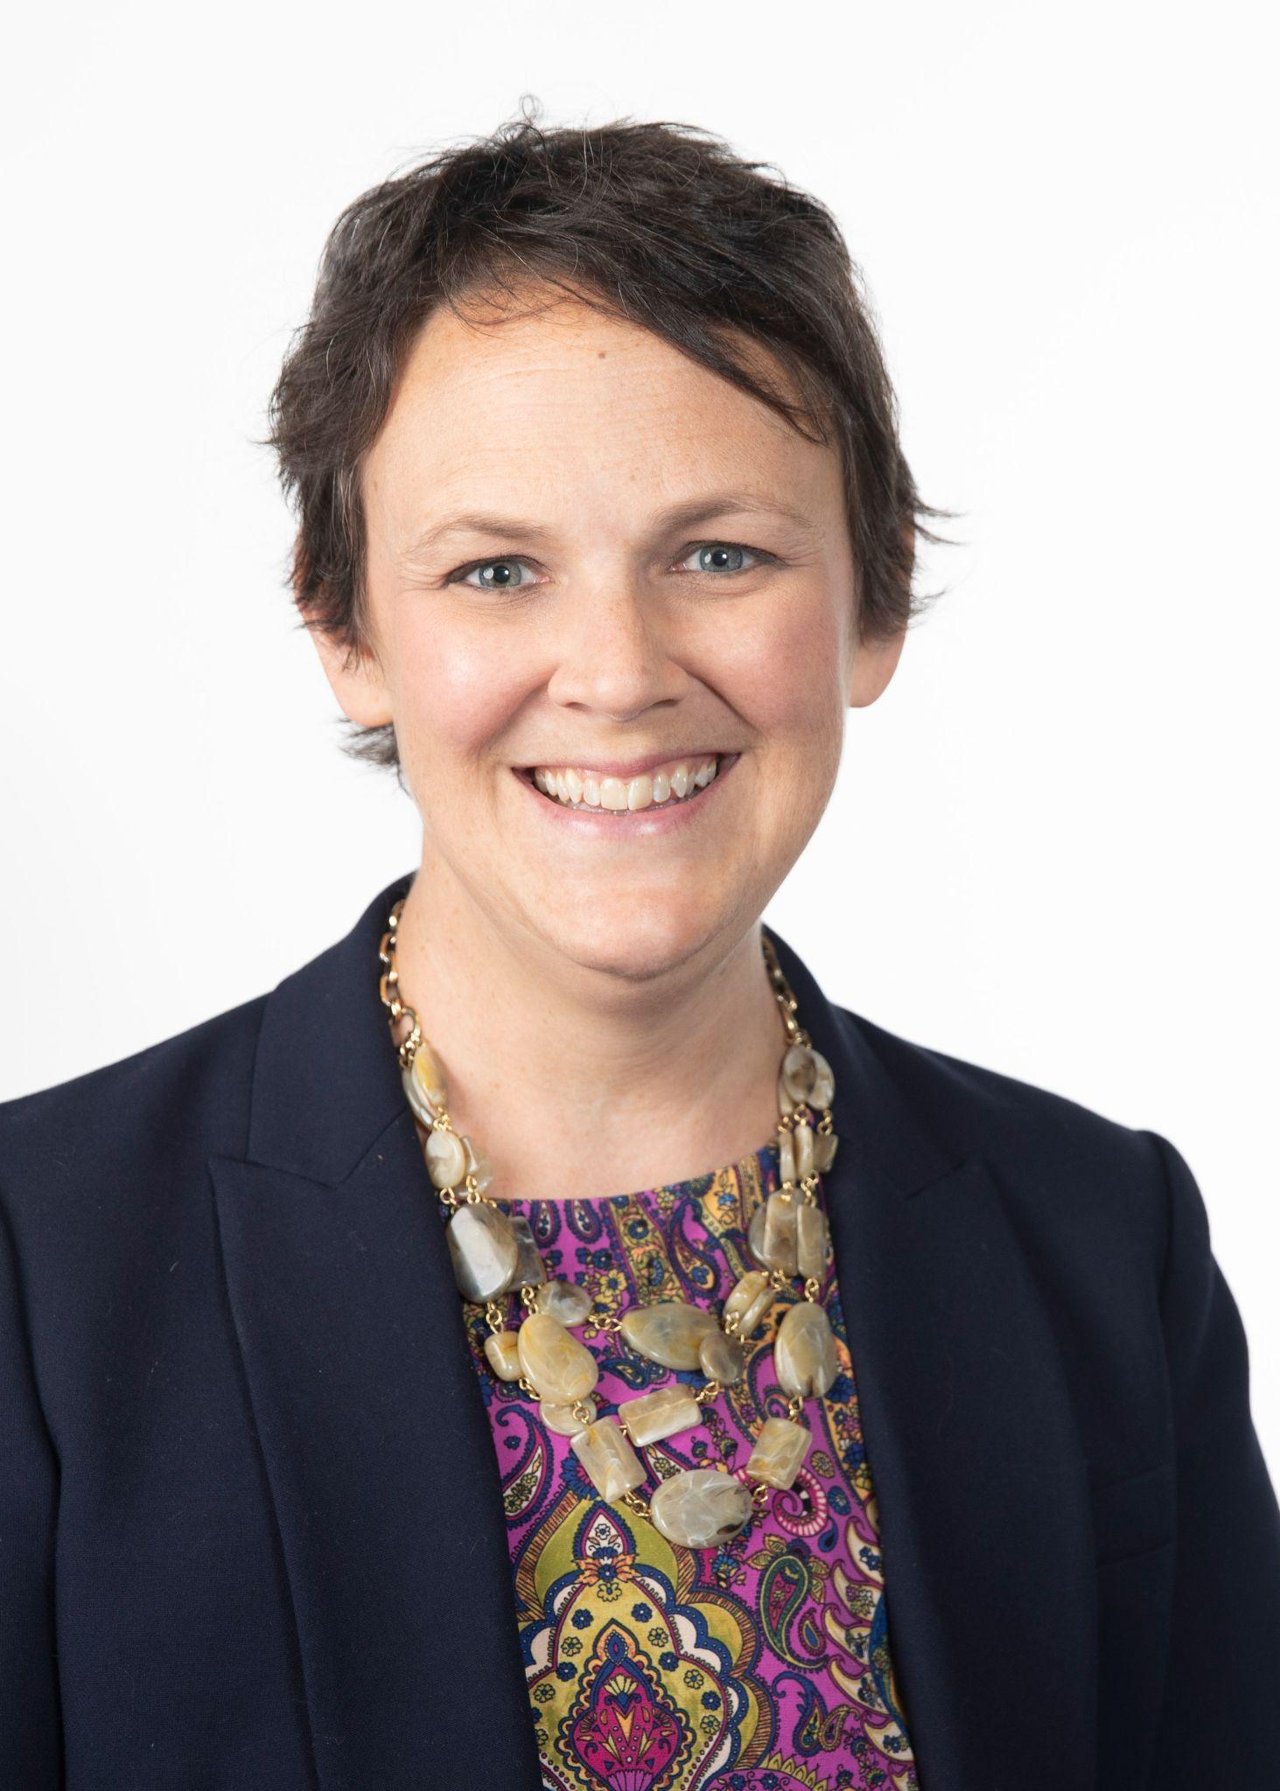

Leading Today’s Webinar
Host
Dr. Karen Marklein, Director, Ayers Institute
Associate Professor, Lead Faculty/Program Director, Instructional Coaching
Expert Voices:
Dr. Suze Gilbert
Associate Professor, Director, Christian Educator Program
Lipscomb University
Dr. Laura Morrow
Director, Center for Teaching and Learning
Lipscomb University

Slide 7
The Neuroscience of Joy
Joy gives us energy
The alternative to joy is fear
Joy is a key to resilience
Joy-filled people are less likely to engage in addictive behaviors
Joy makes us healthier
Warner, M., & Coursey, C. M. (2019). The 4 habits of joy-filled people: 15 minute brain science hacks to a more connected and satisfying life. Northfield Publishing.

Slide 8
Joy is Relational
Not all pleasure is relational, but all JOY is relational
Joy doesn't happen in isolation—it's created and amplified through connection with others.
Co-regulation: Our nervous systems sync with those around us. When we share positive experiences, our joy centers activate together, creating deeper emotional bonds.
Mirror Neurons: Our brains are wired to reflect the emotions we observe. Joy is literally contagious—when students see joy in their teacher and peers, their own joy centers light up.
Belonging Matters: Students experience greater joy when they feel seen, known, and valued within a classroom community. Safe relationships unlock the brain's capacity for joy.
Shared Celebration: Collective moments of gratitude, accomplishment, and play create neural pathways that associate learning with positive connection.

Slide 9
The Neuroscience of Joy
The JOY Center: the right orbital prefrontal cortex that grows with the experience of relational joy.
The JOY Pathways: neurological path that helps us navigate from upsetting emotions in the back of the brain to the joy center in the front of the brain.
Warner, M., & Coursey, C. M. (2019). The 4 habits of joy-filled people: 15 minute brain science hacks to a more connected and satisfying life. Northfield Publishing.

Slide 10
What We See in Schools When Joy Skills Are Low
📋 Functionality Over Connection
We focus on compliance and task completion rather than building genuine relationships
"Did you finish your work?" replaces "How are you doing today?"
🔧 Problem Management Over Joy Restoration
We spend our energy managing behaviors instead of restoring emotional well-being
Discipline becomes about consequences rather than connection and repair
📊 Managing Problems Over Raising Humans
Schools become focused on data, test scores, and behavior charts
We lose sight of our core mission: nurturing the whole child
🛡️ Self-Justified Behavior Becomes Normal
Students (and staff) defend their actions rather than taking responsibility
"It's not my fault" becomes the default response
🎭 Pseudo-Identity Takes Over
Students perform roles rather than showing up authentically
Masks replace genuine self-expression
📈 Troubling Increases
Narcissism - "It's all about me" thinking dominates
Unresolved conflicts - Issues pile up without repair
Addictive behaviors - Students seek external sources of dopamine (screens, substances, drama)

Slide 11
The Good News:
Joy Skills Can Be Taught, Practiced, Strengthened! 🌟
🧠 Your Brain is Designed for Joy: Neural pathways grow stronger with practice
💪 Skills, Not Just Feelings: Joy is something we can actively build
🔄 It's Never Too Late: Neuroplasticity means change is always possible
👥 We Do This Together: Joy grows best in community
📈 Small Steps = Big Impact: Consistent practice creates lasting change

Slide 12
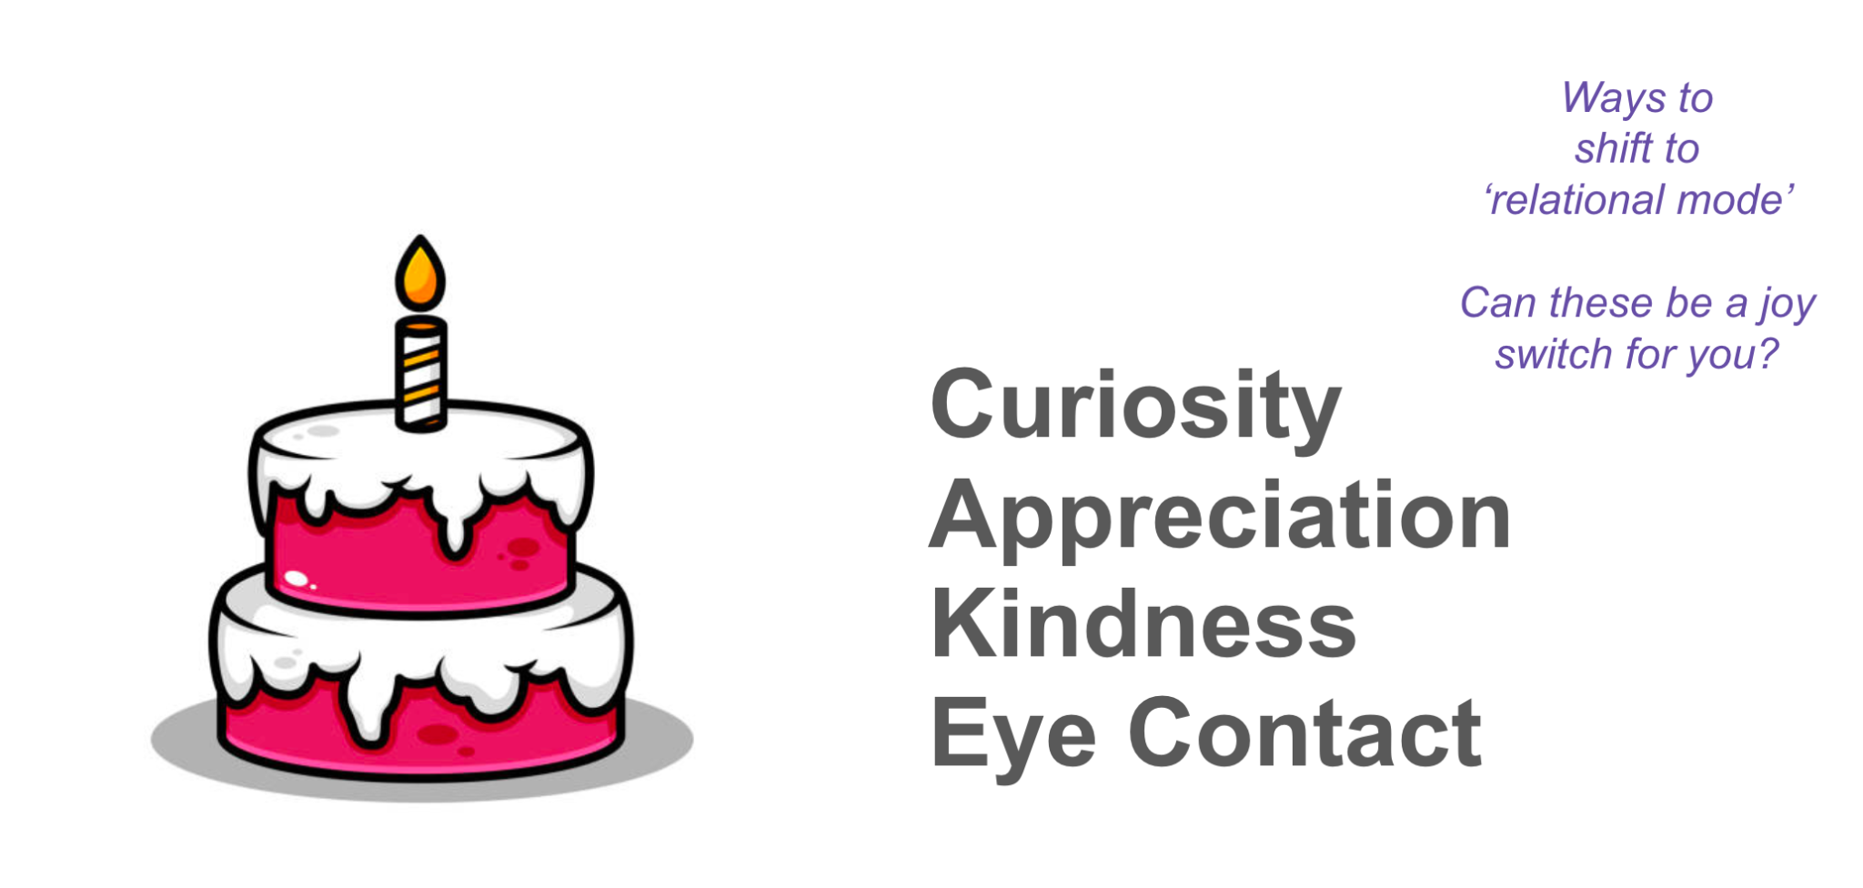
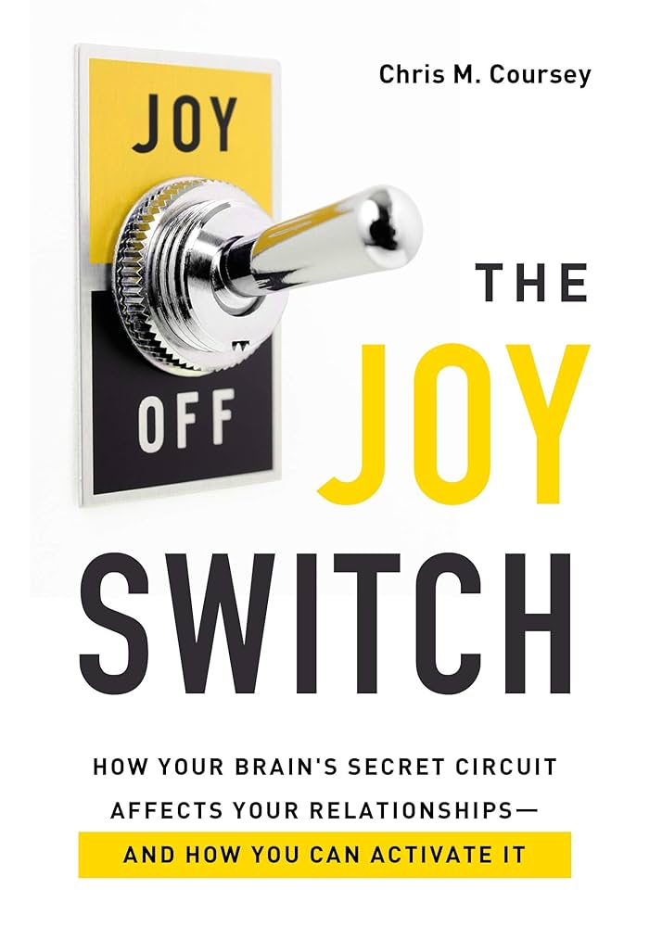
The Good News:
Joy Skills Can Be Taught, Practiced, Strengthened! 🌟

Slide 13
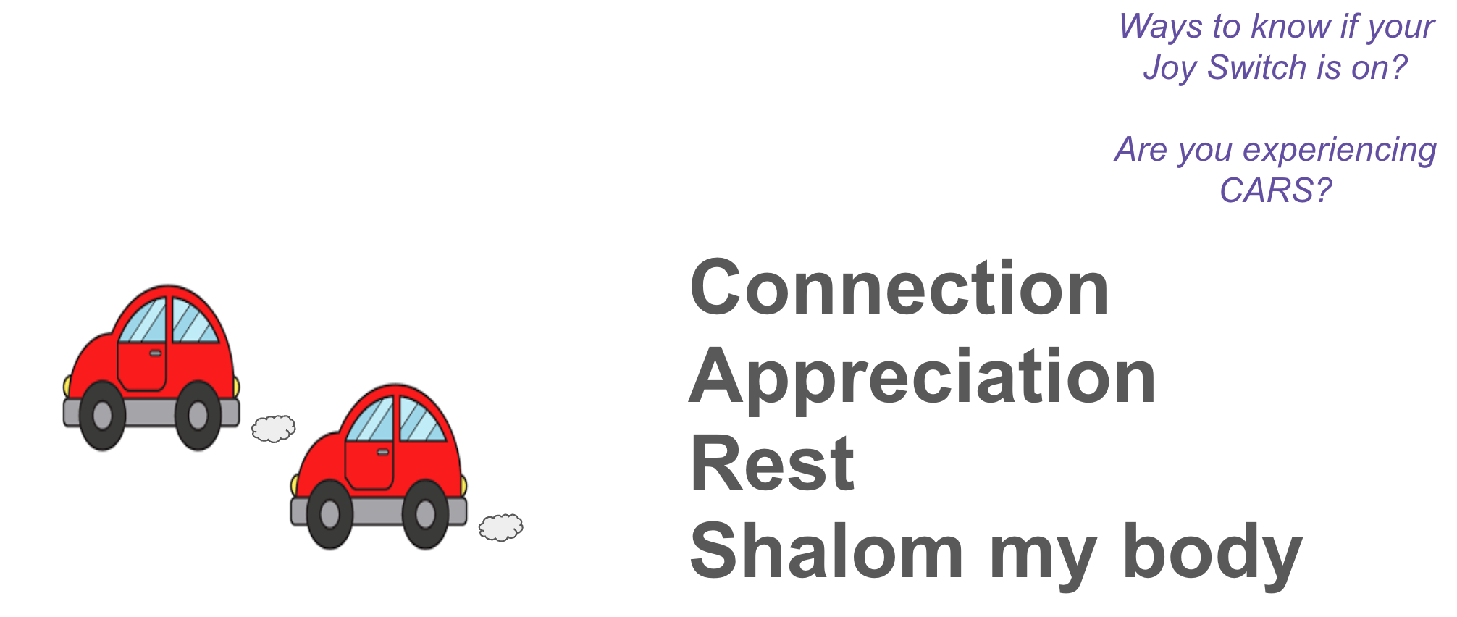
The Good News:
Joy Skills Can Be Taught, Practiced, Strengthened! 🌟

Slide 14
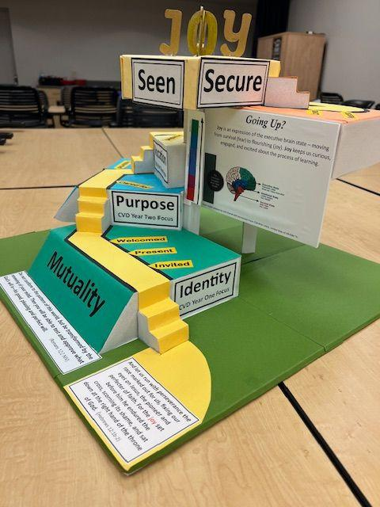
The Good News:
Joy Skills Can Be Taught, Practiced, Strengthened! 🌟
Mutuality
Invited? Welcomed? Present?
Engagement
Supported? Cared For?
Safety
Known? Accepted?
Transformation
Loved? Needed? Befriended?
Adapted from Wheaton’s Center for Faith and Disability, 10 Dimensions of Belonging

Slide 15
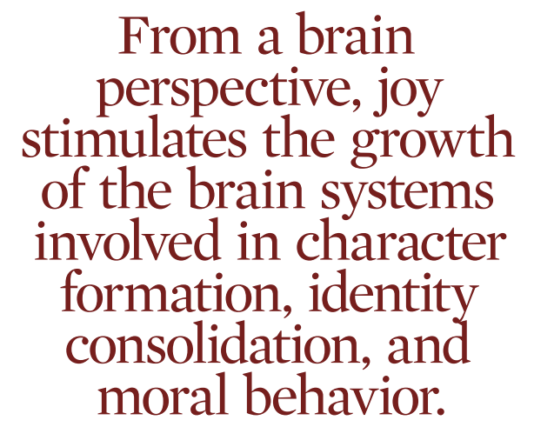
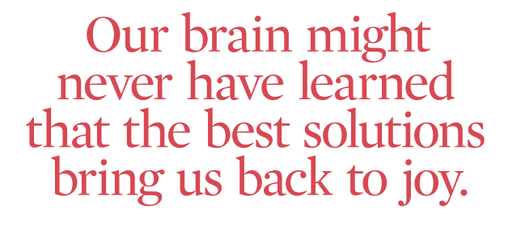
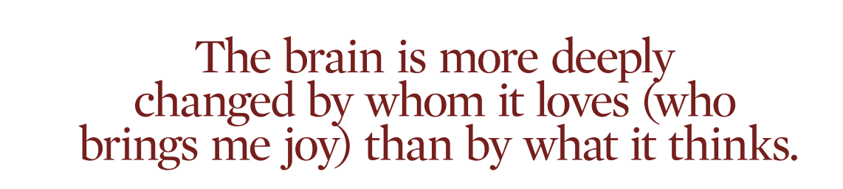
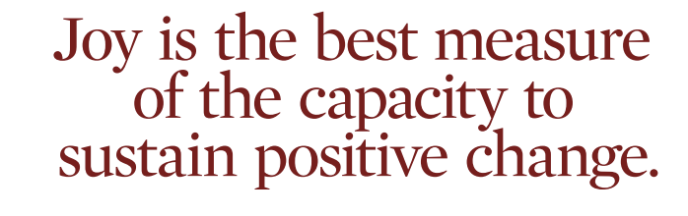
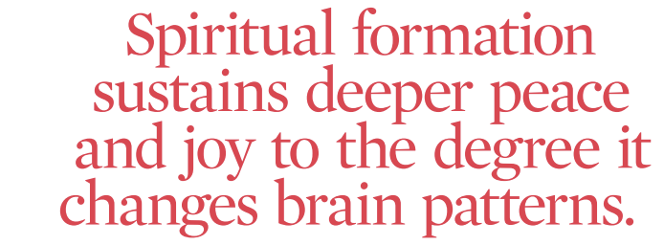
The Good News:
Joy Skills Can Be Taught, Practiced, Strengthened! 🌟
Wilder, J. (2014). Joy changes everything. Conversations Journal: A Forum for Authentic Transformation, 12(2).

Slide 16
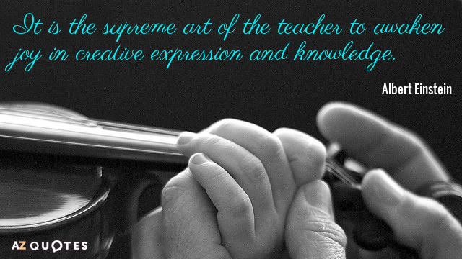
“It is the supreme art of the teacher to awaken joy in creative expression and knowledge…”
20XX

Slide 17
References
Coursey, C. M. (2021). The joy switch: How your brain's secret circuit affects your relationships—and how you can activate it. Northfield Publishing.
Conscious Discipline. (n.d.). Brain state model. https://consciousdiscipline.com/methodology/brain-state-model
Warner, M., & Coursey, C. M. (2019). The 4 habits of joy-filled people: 15 minute brain science hacks to a more connected and satisfying life. Northfield Publishing.
Wilder, J. (2014). Joy changes everything. Conversations Journal: A Forum for Authentic Transformation, 12(2).

Slide 18
Christian Educator Program
If you possess an undergraduate degree, you may pursue a certificate in the Christian Educator Program (CEP) to prepare for the pedagogy, content and cultural facets of teaching in a Christian school setting. This program provides the coursework and skill development you need to be successful with your students in this educational environment. Christian Educator Program coursework includes field experiences in Christian school environments. Candidates may also complete additional courses and licensure exams to complete a Tennessee teacher license and/or Master’s/Ed.S. degree.
Pathways through the Christian Educators Program Include:
Teaching License in
Prek-3/SPED or
K-5 or
Secondary content or
Special Education.
School Counseling
Special Education
Applied Behavior Analysis
Reading Specialist
Gifted Certification
Instructional Coaching Certification
English Language Learning Certification

Slide 19
APPLICATION PROCESS
https://grad.lipscomb.edu/apply/
INFO25
Graduate Fee Waiver Code

Slide 20
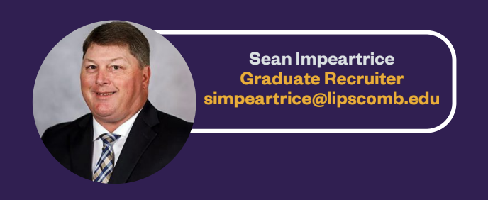
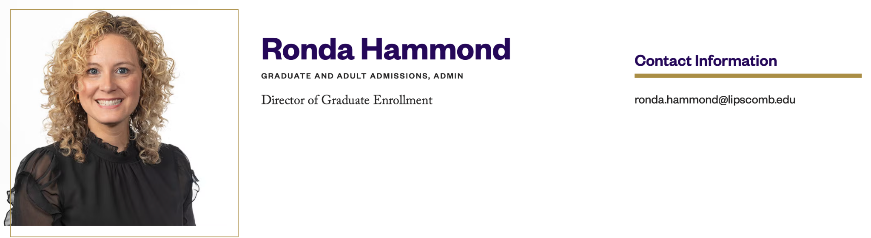

Lipscomb University
Graduate Admissions Contact Information

Slide 21

Reflection
Complete this statement:
Based on what I have learned today, one thing I will try is...

Slide 22

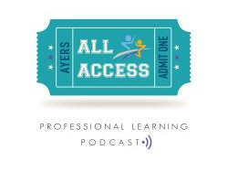
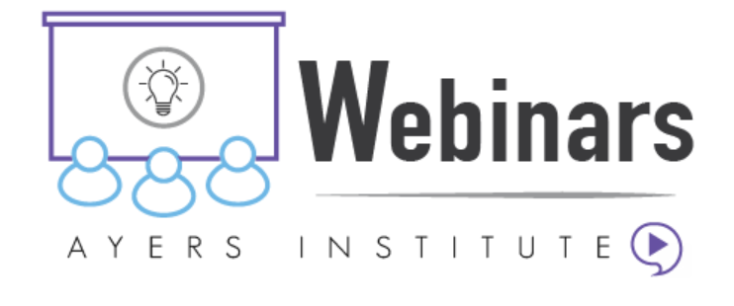
Stay in touch!
Website: ayersinstitute.org
Mailing list signup on the home page
Follow us on social media:
@ayersinstitute @LipscombCofE
Check out our archived podcasts and webinars!

